Slide 1
Coherent encoding of subjective spatial position in visual cortex and hippocampus
Aman B. Saleem, E. Mika Diamanti, Julien Fournier, Kenneth D. Harris & Matteo Carandini
Nature, 2018

Slide 2
Abstract

Slide 3
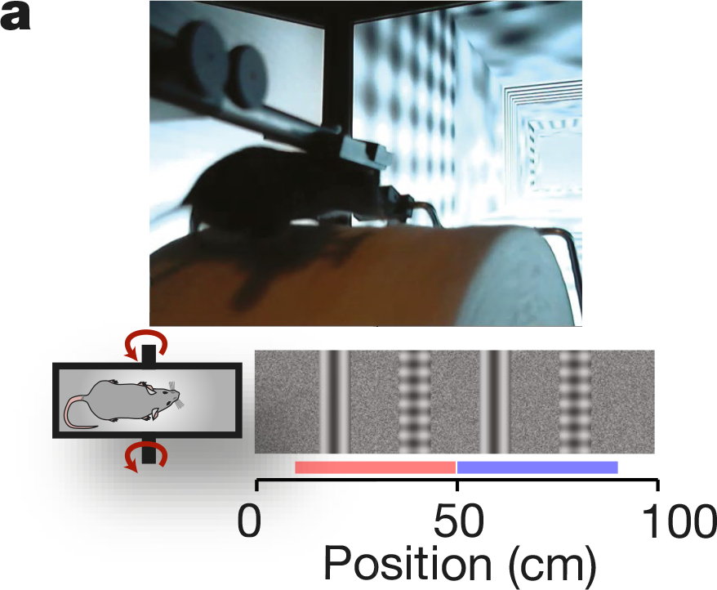
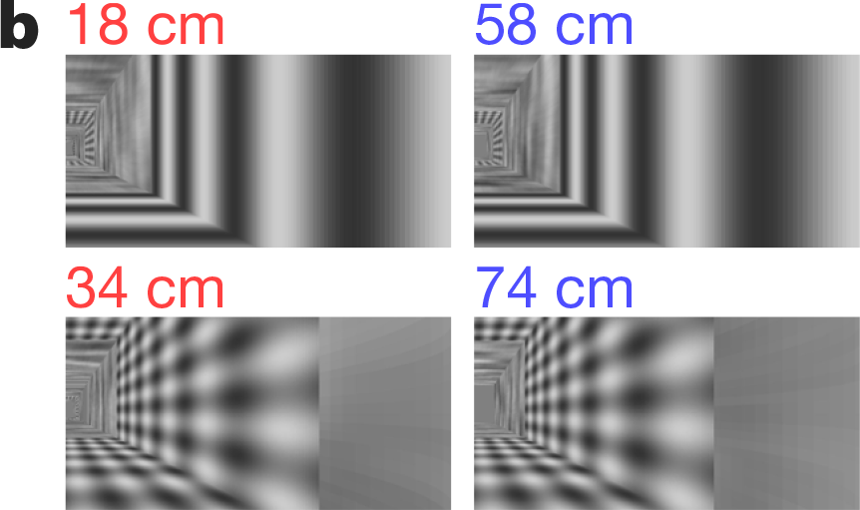
Task Design

Slide 4
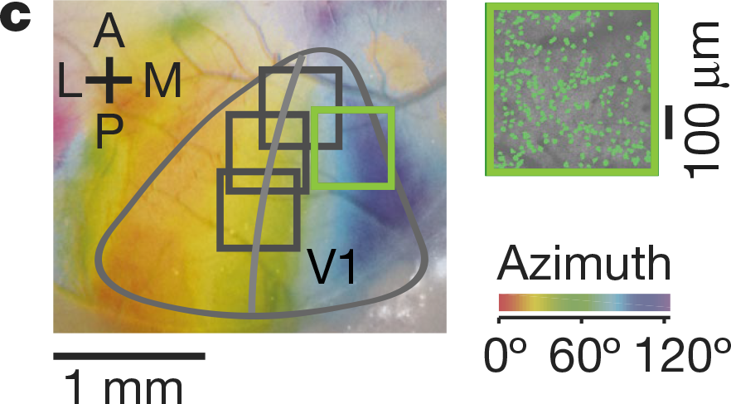
2-photon Imaging
Notes:
To measure retinotopy we presented a 14° wide vertical window containing a vertical grating (spatial frequency 0.15 cycles per degree), and swept37,38 the horizontal position of the window over 135° of azimuth angle, at a frequency of 2 Hz. Stimuli lasted 4 s and were repeated 20 times (10 in each direction). We obtained maps for preferred azimuth by combining responses to the two stimuli moving in opposite directions, as previously described37

Slide 5
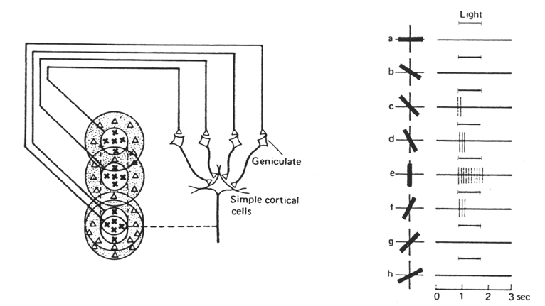
Receptive Fields in V1

Slide 6
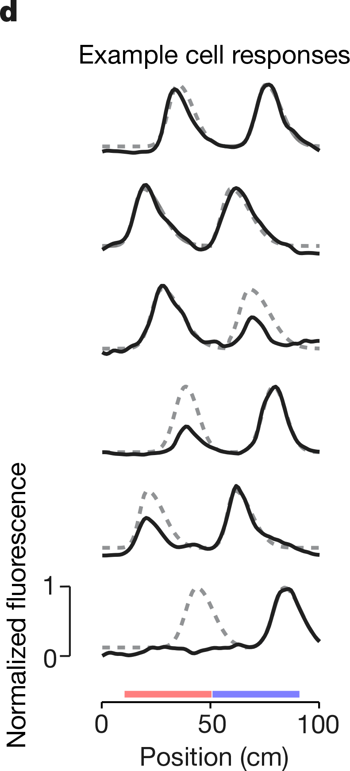
Position coding in V1
Neurons showed different responses to identical visual stimuli, depending on position of encounter.

Slide 7
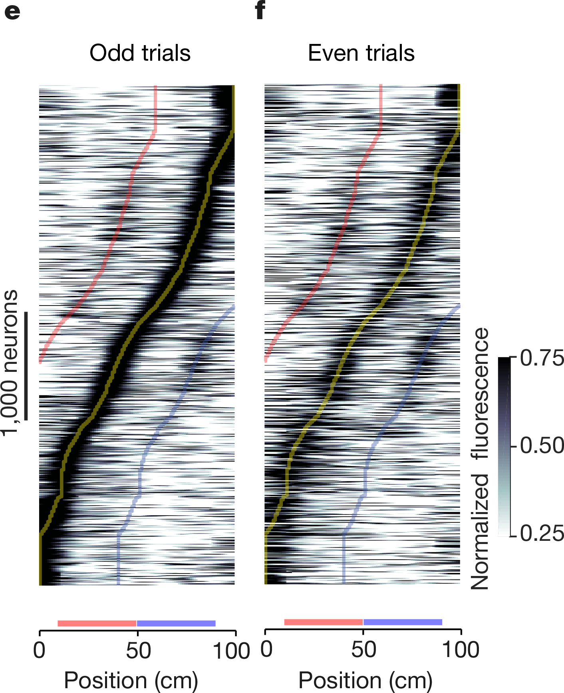
Position coding in V1
Neurons showed different responses to identical visual stimuli, depending on position of encounter.
Notes:
Neurons are ordered by the position of their maximum response. f, As in e for even trials. Curves indicate preferred position (yellow) and preferred position±40 cm (blue and red)
e,f show 4,958 neurons averaged across odd or even trials.

Slide 8
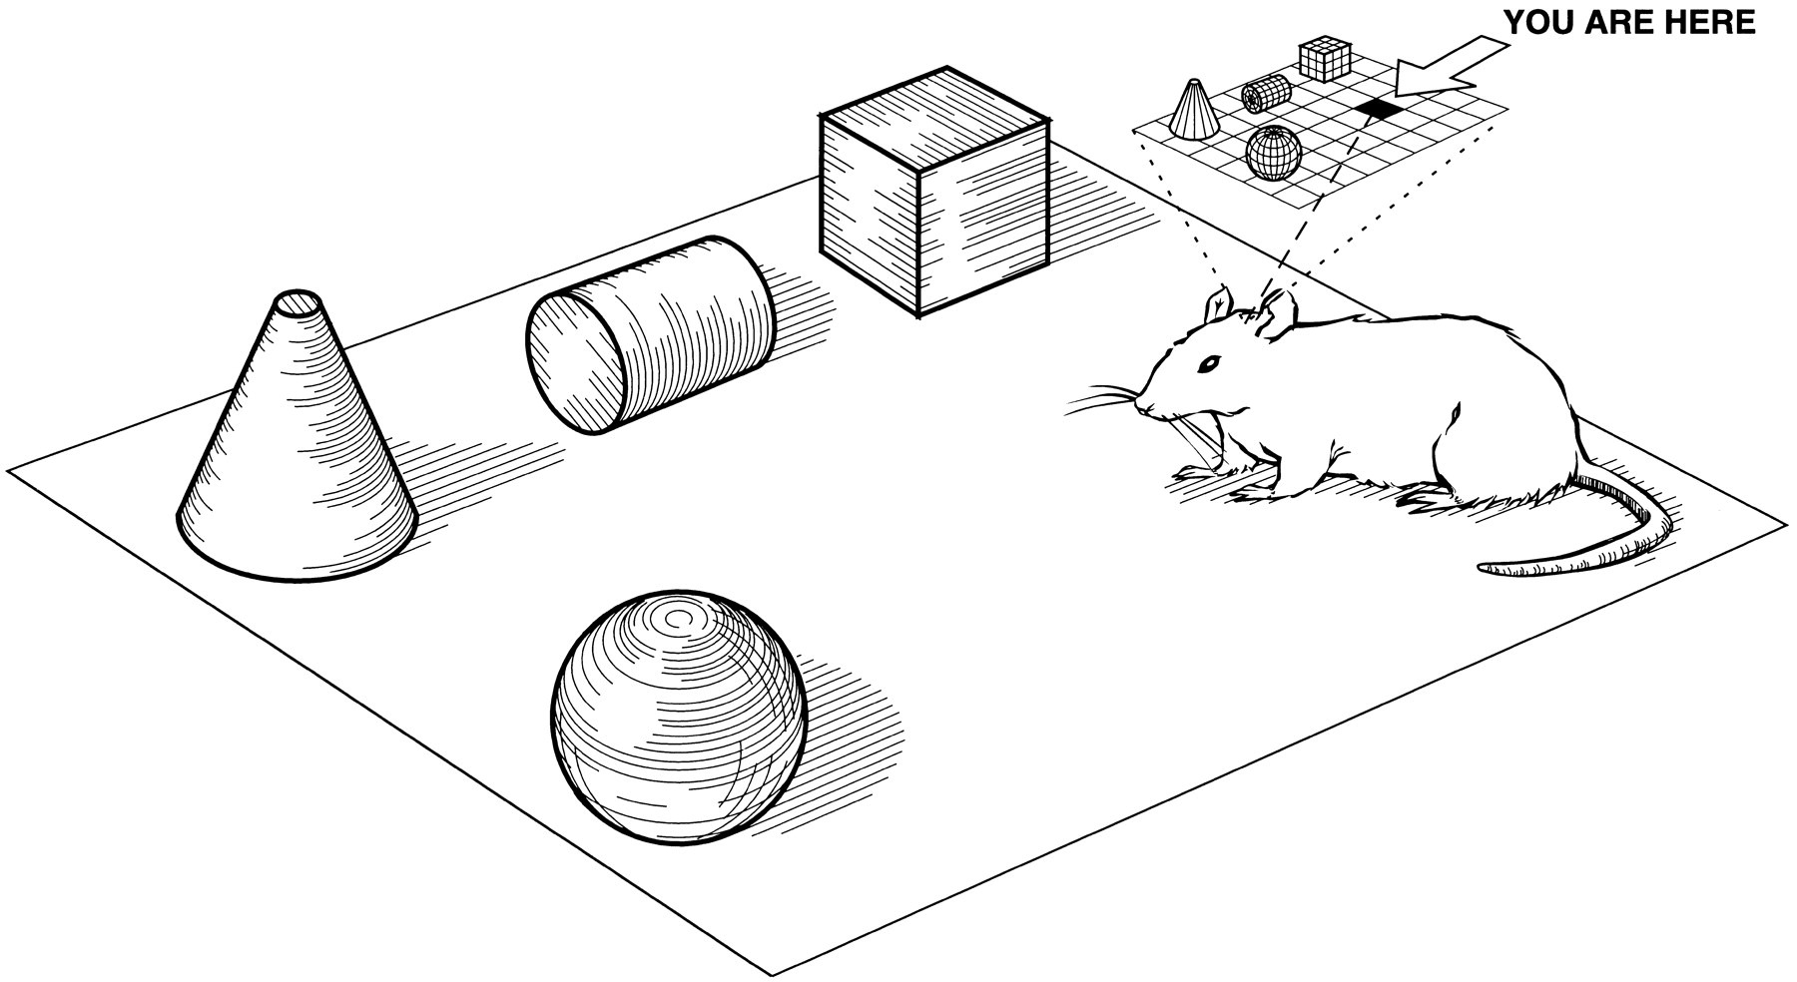
V1 responses driven by hippocampus?
The observed selectivity could be based on V1-local computations.
But what if they are driven by hippocampal cognitive maps?
Image from Eichenbaum et al., 1999
Notes:
Neurons are ordered by the position of their maximum response. f, As in e for even trials. Curves indicate preferred position (yellow) and preferred position±40 cm (blue and red)
e,f show 4,958 neurons averaged across odd or even trials.

Slide 9
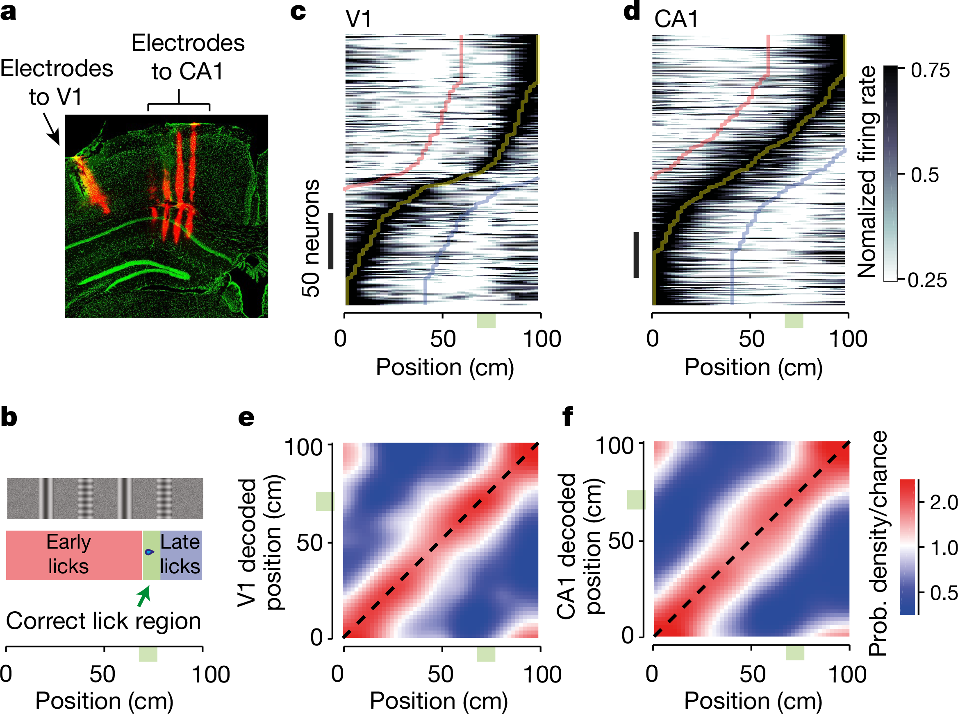
CA1→V1

Slide 10
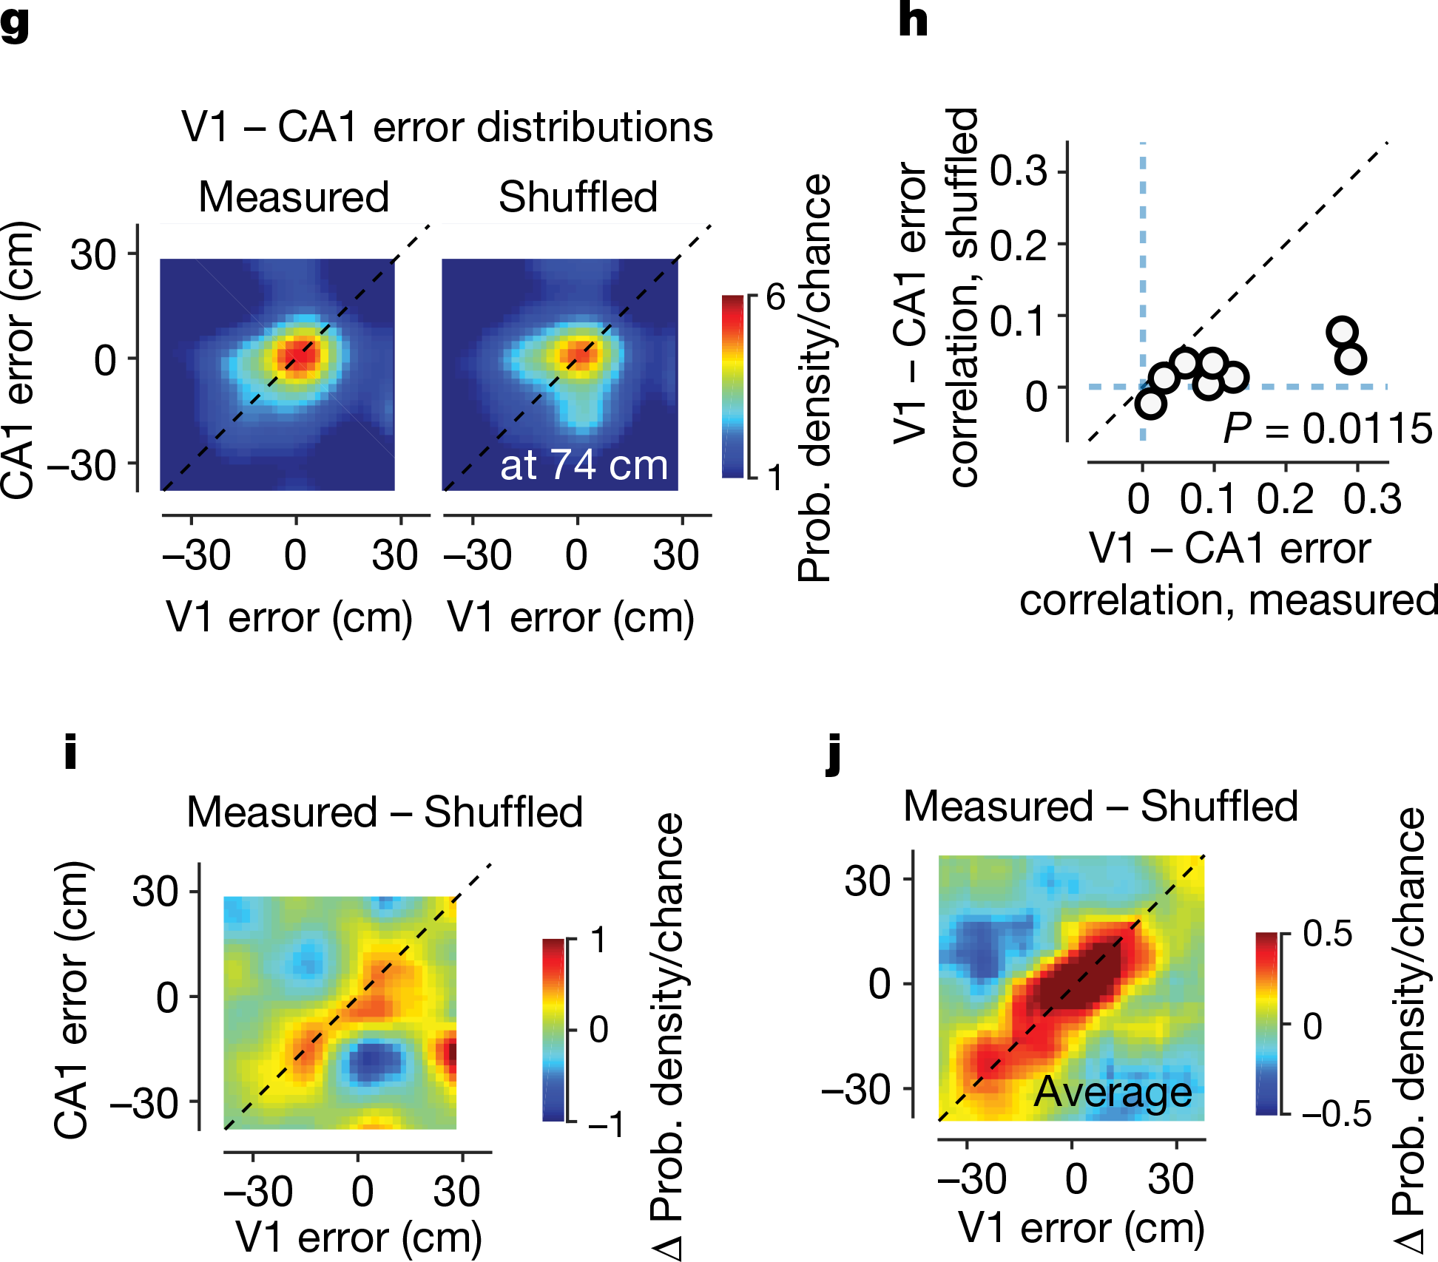
CA1→V1

Slide 11
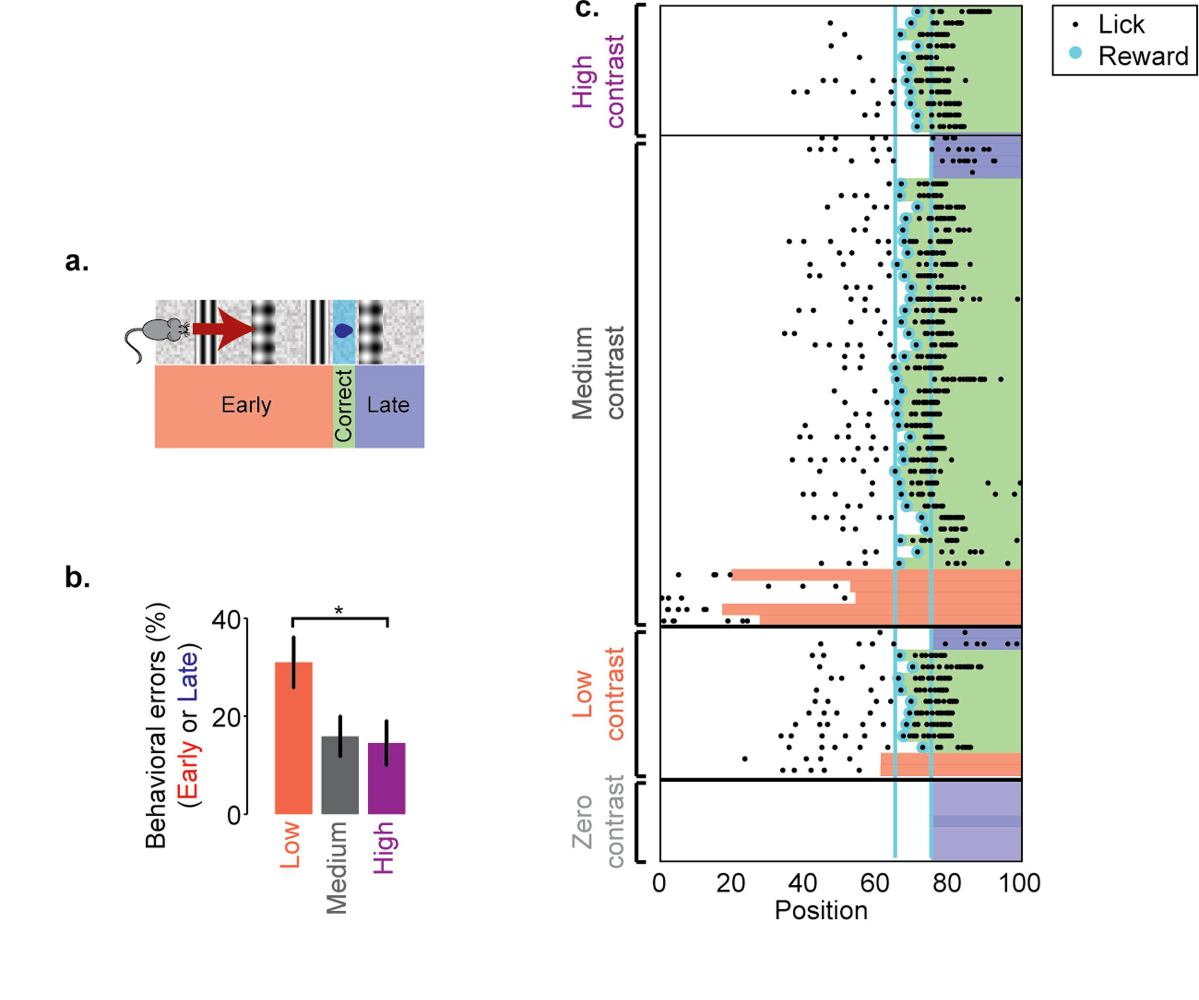
Is the task visual?

Slide 12
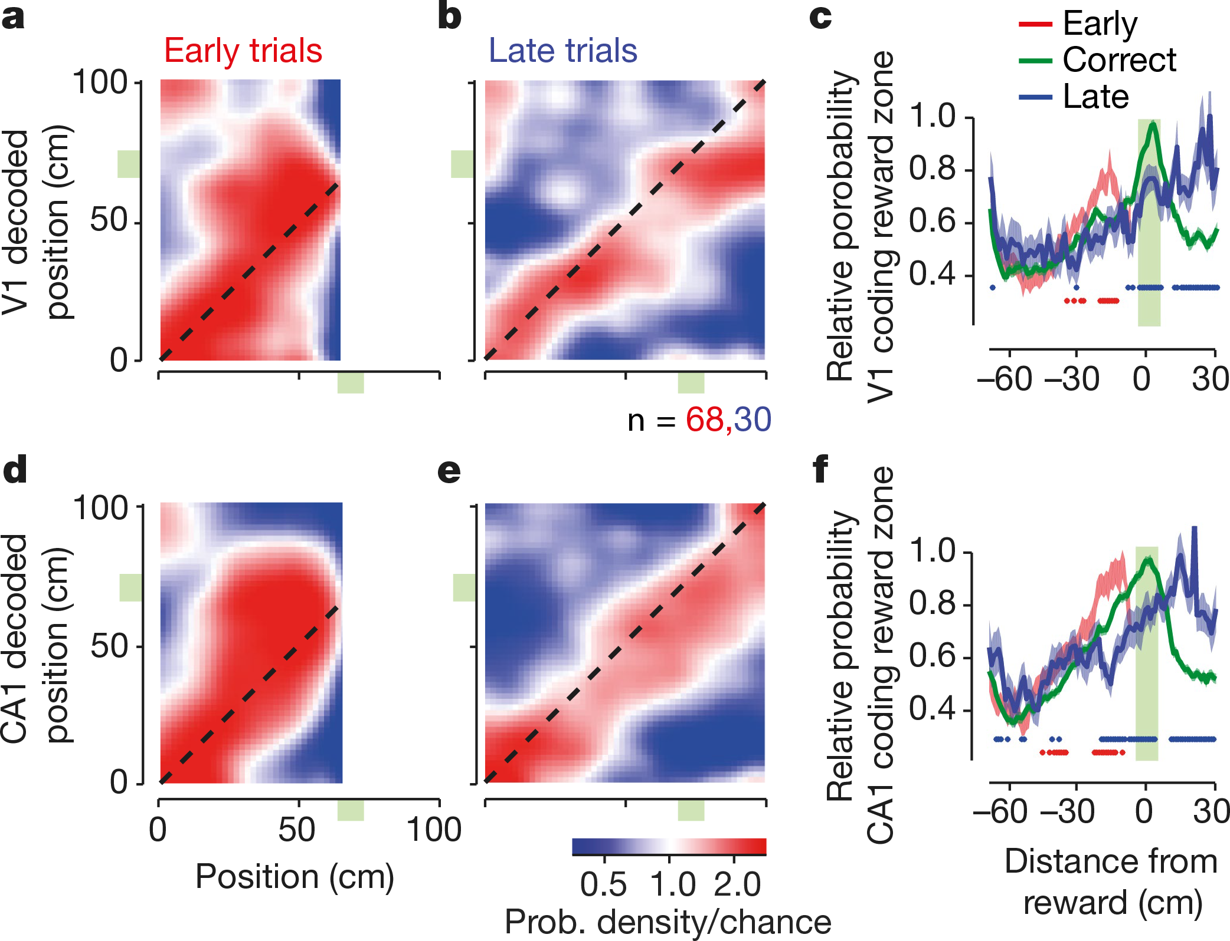
Subjective Position

Slide 13
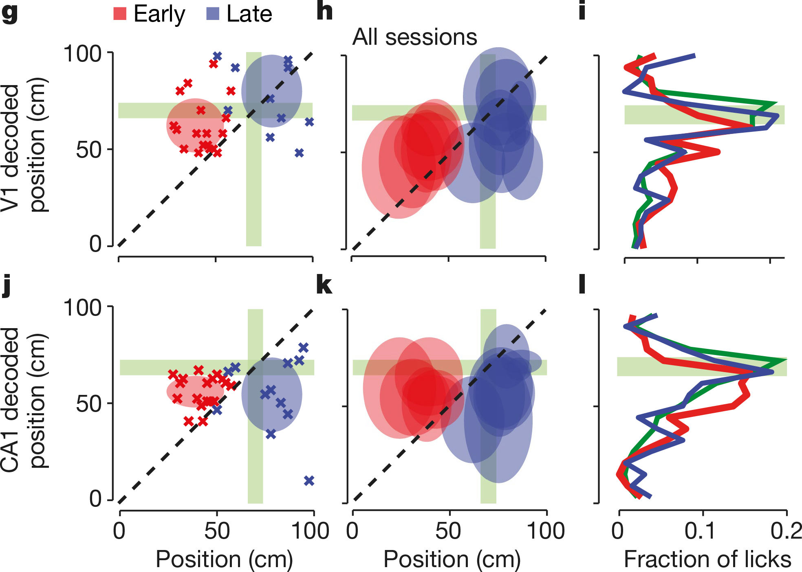
Subjective Position

Slide 14
Questions?
The authors looked at RFs greater than 40° azimuth.
Mice don’t have fovea.
Would we expect similar spatial tuning properties across the retinotopic map of a primate?

